Slide 1
Gauss’s Law

Slide 2
Topics being covered– Gauss’s Law
Electric flux
Gauss’s Law
Application of Gauss’s Law to various charge distributions
Conductors in electrostatic equilibrium

Slide 3
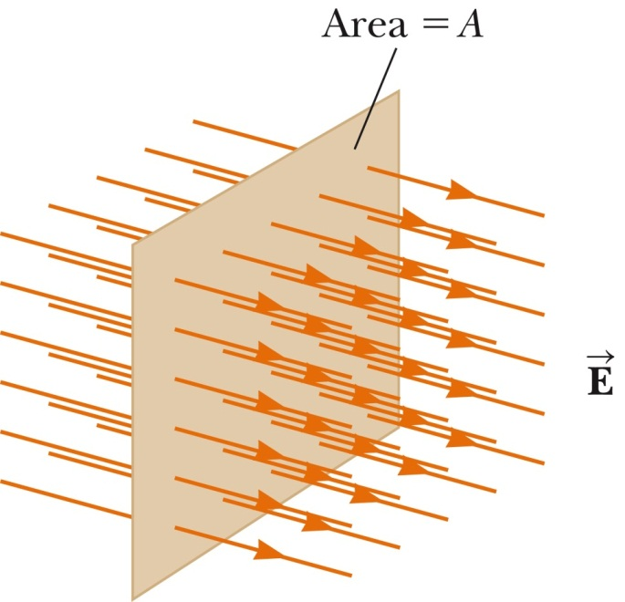
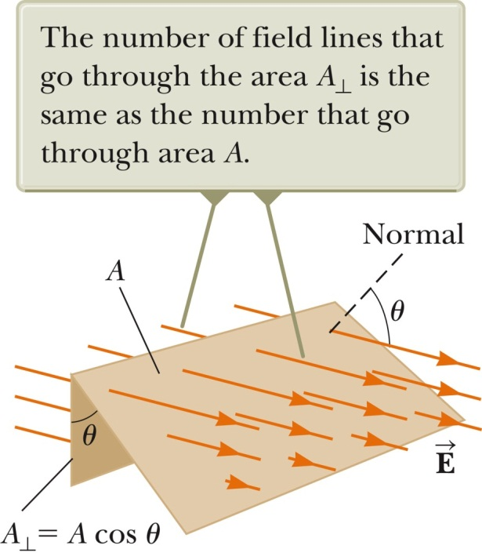
Electric Flux
Electric flux is the product of the magnitude of the electric field and the surface area, A, perpendicular to the field: Φ_{E} = EA, units: N · m² / C
The electric flux is proportional to the number of electric field lines penetrating some surface. The field lines may make some angle θ with the normal direction of the surface, then
The flux is a maximum when the surface is perpendicular to the field: θ = 0º.
The flux is zero when the surface is parallel to the field: θ = 90º.
If the field varies over the surface, Φ = EA cos θ is valid for only a small element of the area.

Slide 4
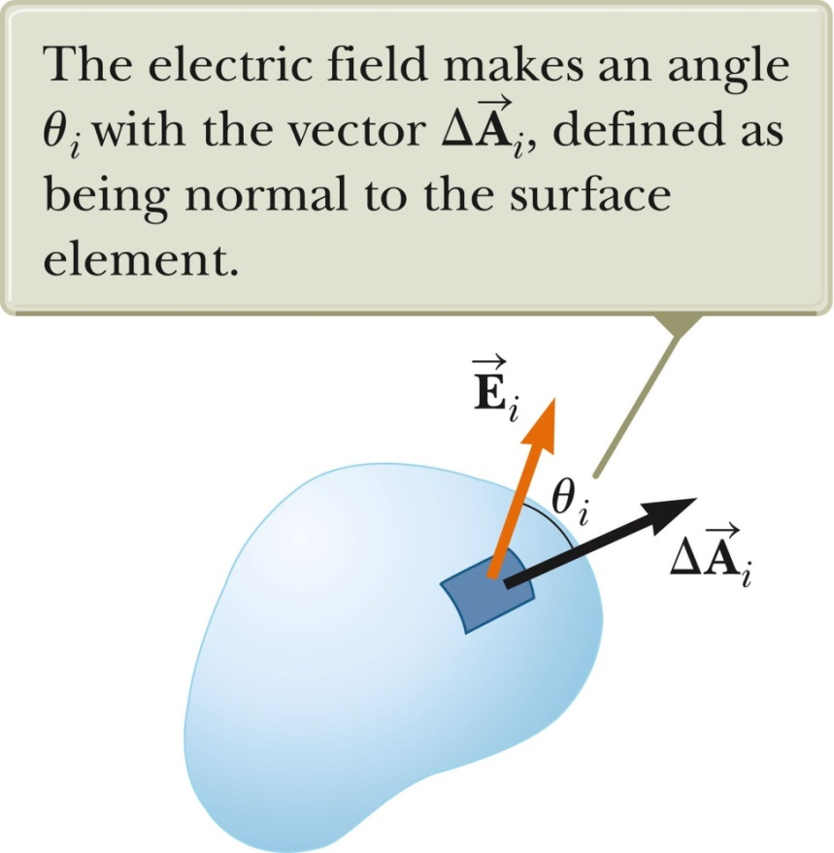
Electric Flux, General
In a more general case, look at a small area element.
In general, this becomes
The surface integral means the integral must be evaluated over the surface in question.
In general, the value of the flux will depend both on the field pattern and on the surface.

Slide 5
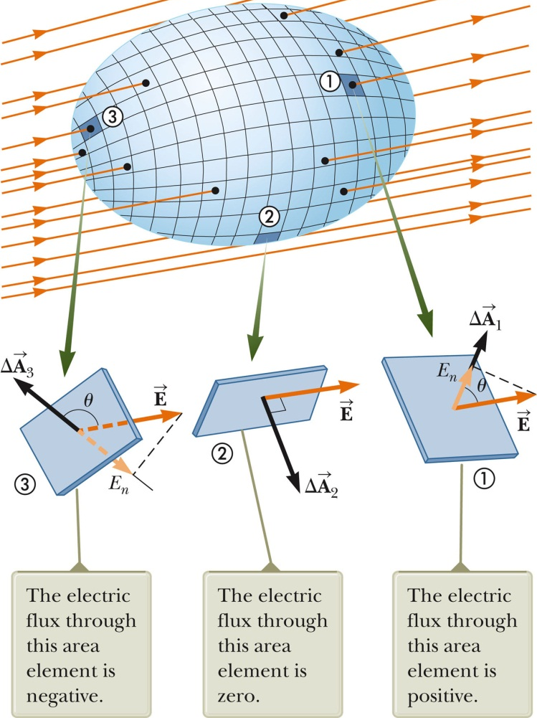
Electric Flux, Closed Surface
Assume a closed surface
The vectors point in different directions.
At each point, they are perpendicular to the surface.
By convention, they point outward.
At (1), the field lines are crossing the surface from the inside to the outside; θ < 90º, Φ is positive.
At (2), the field lines graze surface; θ = 90º, Φ = 0.
At (3), the field lines are crossing the surface from the outside to the inside;180º > θ > 90º, Φ is negative.

Slide 6
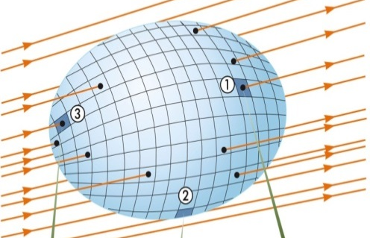
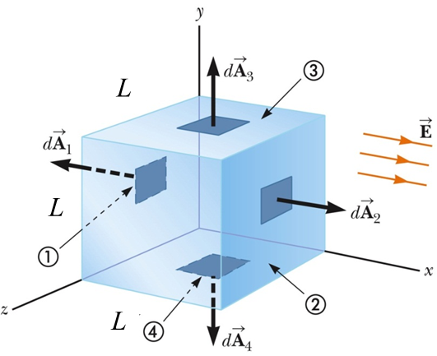
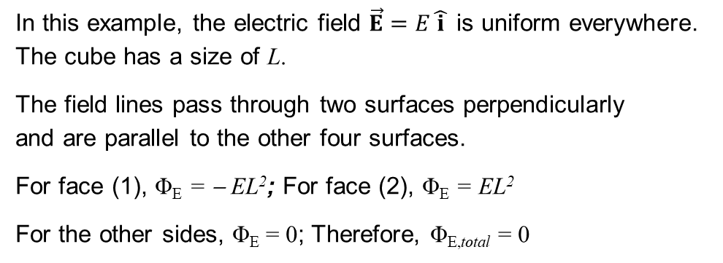
Flux Through Closed Surface, final
The net flux through the surface is proportional to the net number of lines leaving the surface.
This net number of lines is the number of lines leaving the surface minus the number entering the surface.
If E_{n} is the component of the field perpendicular to the surface, then
The integral is over a closed surface.
closed surface
Flux Through a Cube, Example
In this example, the electric field $\vec{E}=E\hat{ i }$ is uniform everywhere. The cube has a size of L.
The field lines pass through two surfaces perpendicularly and are parallel to the other four surfaces.
For face (1), Φ_{E} = − EL²; For face (2), Φ_{E} = EL²
For the other sides, Φ_{E} = 0; Therefore, Φ_{E,total} = 0

Slide 7
Gauss’s Law, Introduction
Gauss’s law is an expression of the general relationship between the net electric flux through a closed surface and the charge enclosed by the surface.
The closed surface is often called a Gaussian surface.
Gauss’s law
is of fundamental importance in the study of electric fields.
can be used as an alternative procedure for calculating electric fields, particularly for the electric field of highly symmetric charge distributions.
is based on the inverse-square behavior of the electric force between point charges.
is important in understanding and verifying the properties of conductors in electrostatic equilibrium.

Slide 8
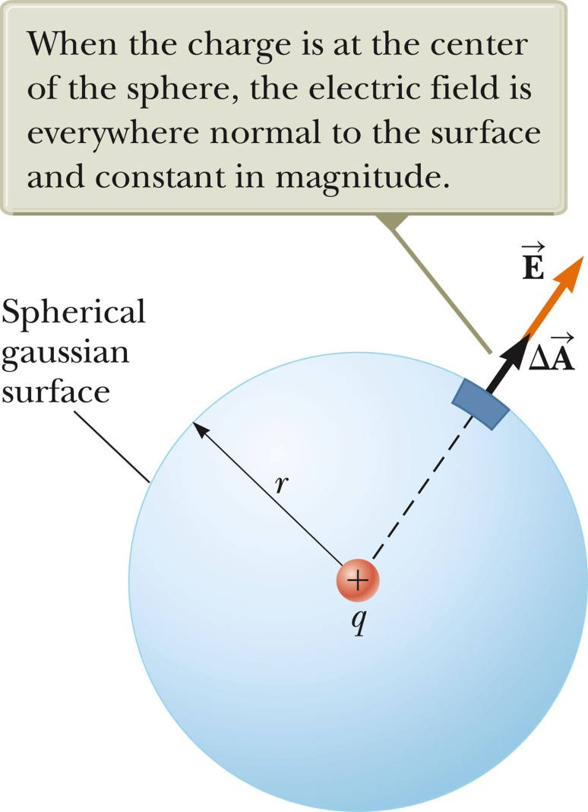
Gauss’s Law – Single charge example
A positive point charge, q, is located at the center of a sphere of radius r.
The magnitude of the electric field everywhere on the surface of the sphere is
E = k_{e}q / r²
The field lines are directed radially outward and are perpendicular to the surface at every point.
This will be the net flux through the Gaussian surface, the sphere of radius r.
We know E = k_{e}q/r² and A_{sphere} = 4πr², then

Slide 9
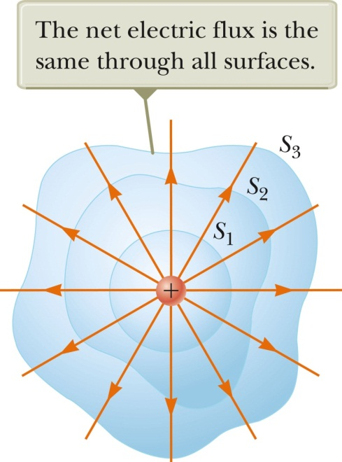
Gauss’s Law – General
Gauss’s Law:
Any closed surface surrounds charge q, the electric flux is
Inferences:
The electric flux is independent of the shape of surface
If no charge inside, Φ_{E} = 0

Slide 10
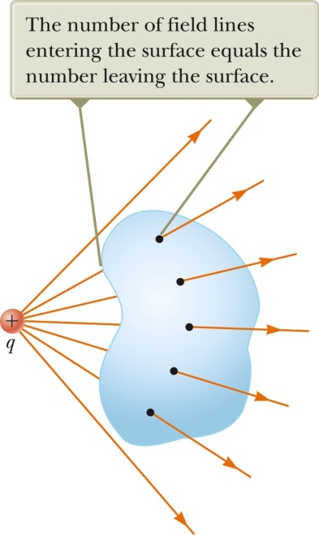
Gauss’s Law – General, notes
The net flux through any closed surface surrounding a point charge, q, is given by q/ɛ₀ and is independent of the shape of that surface.
The net electric flux through a closed surface that surrounds no charge is zero.
Since the electric field due to many charges is the vector sum of the electric fields produced by the individual charges, the flux through any closed surface can be expressed as
Gaussian Surface, Example
Closed surfaces of various shapes can surround the charge. Only S₁ is spherical - verifies the net flux through any closed surface surrounding a point charge q is given by q/ɛ₀ and is independent of the shape of the surface.
The charge is outside the closed surface with an arbitrary shape. Any field line entering the surface leaves at another point. - verifies the electric flux through a closed surface that surrounds no charge is zero.

Slide 11
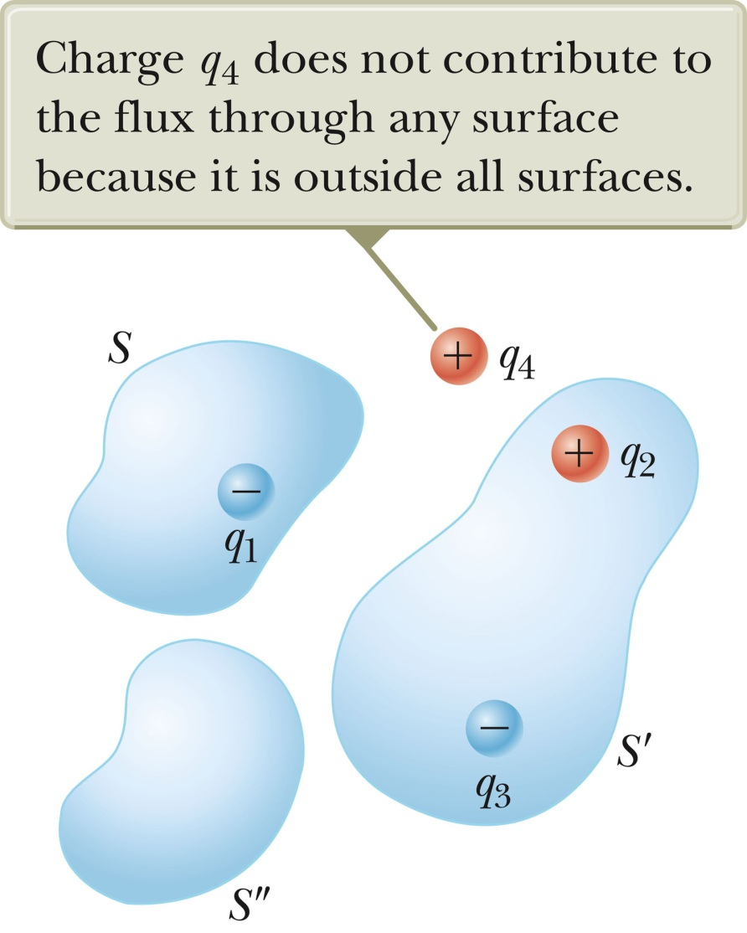


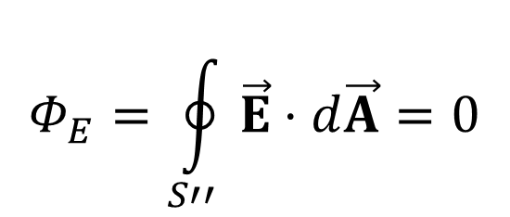
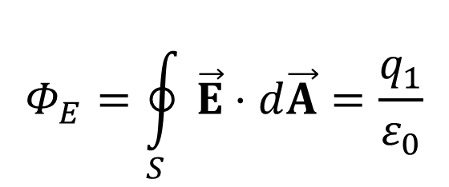

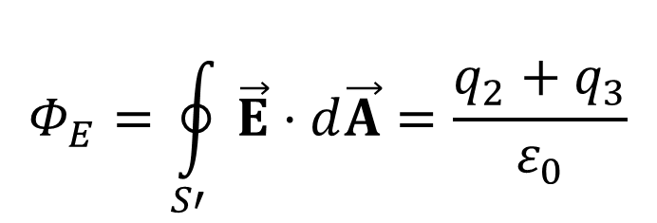

Electric flux through a Gaussian surface –
Example of multiple point charges
$$Φ_{E}=\oint_{S}{\vec{E}⋅d\vec{A}}=\frac{q_{1}}{ε_{0}}$$
Flux through surface $S$:
Flux through surface $S′$:
$$Φ_{E}=\oint_{S′}{\vec{E}⋅d\vec{A}}=\frac{q_{2}+q_{3}}{ε_{0}}$$
<0
$$Φ_{E}=\oint_{S′′}{\vec{E}⋅d\vec{A}}=0$$
Flux through surface $S′′$:
<0
Note: $S$, $S′$, and $S′′$ are all closed surfaces
Notes:
Figure 24.9
The net electric flux through any closed surface depends only on the charge inside that surface. The net flux through surface is q₁/ε₀, the net flux through surface S’ is (q₂ + q₃)/ε₀, and the net flux through surface S’’ is zero.

Slide 12
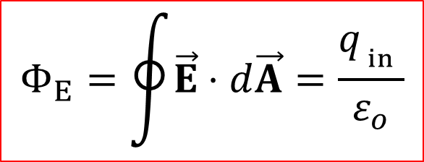
Gauss’s Law – Mathematics
$$Φ_{E}=\oint{\vec{E}⋅d\vec{A}=\frac{{q_{ _{in}}}_{ }}{ε_{o}}}$$
The mathematical form of Gauss’s law states
q_{in} is the net charge inside the surface.
represents the electric field at any point on the surface.
is the total electric field and may have contributions from charges both inside and outside of the surface.
Although Gauss’s law can, in theory, be solved to find for any charge configuration, in practice it is limited to symmetric situations.
Applying Gauss’s Law
To use Gauss’s law, you want to choose a Gaussian surface over which the surface integral can be simplified and the electric field determined.
Take advantage of symmetry.
Remember, the Gaussian surface is a surface you choose, it does not have to coincide with a real surface.

Slide 13

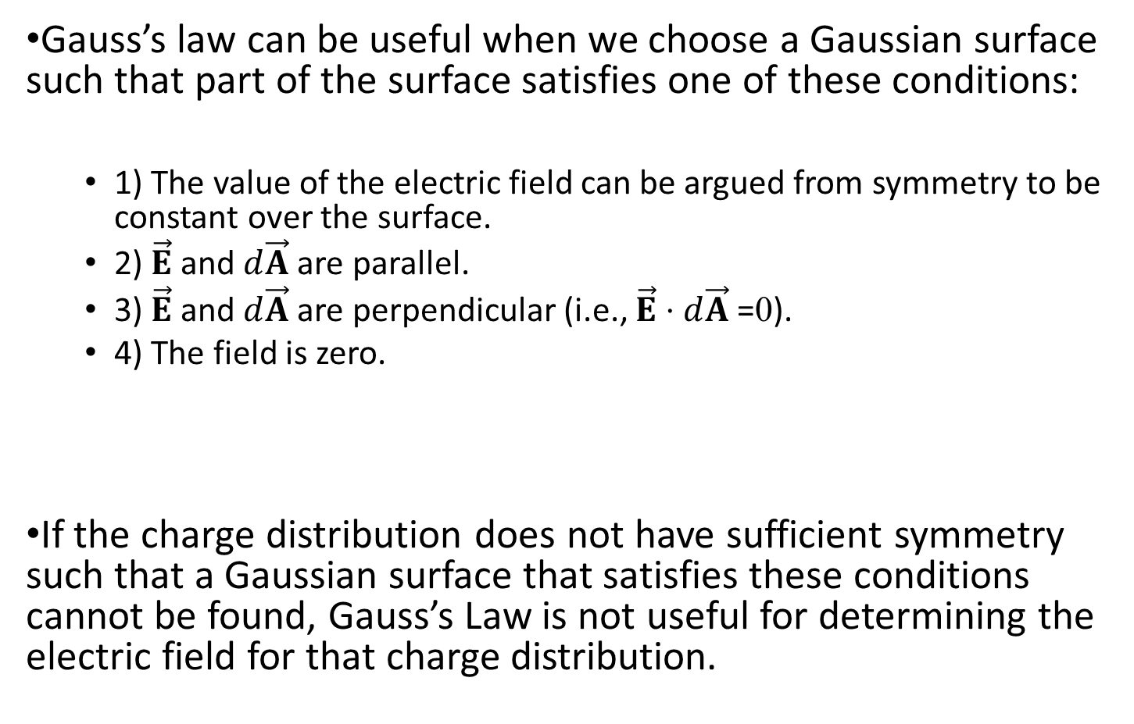
Conditions for a Gaussian Surface
Gauss’s law can be useful when we choose a Gaussian surface such that part of the surface satisfies one of these conditions:
1) The value of the electric field can be argued from symmetry to be constant over the surface.
2) $\vec{E}$ and $d\vec{A}$ are parallel.
3) $\vec{E}$ and $d\vec{A}$ are perpendicular (i.e., $\vec{E}⋅d\vec{A}$=0).
4) The field is zero.
If the charge distribution does not have sufficient symmetry such that a Gaussian surface that satisfies these conditions cannot be found, Gauss’s Law is not useful for determining the electric field for that charge distribution.
$$Φ_{E}=\oint{\vec{E}⋅d\vec{A}=\frac{{q_{ _{in}}}_{ }}{ε_{o}}}$$

Slide 14
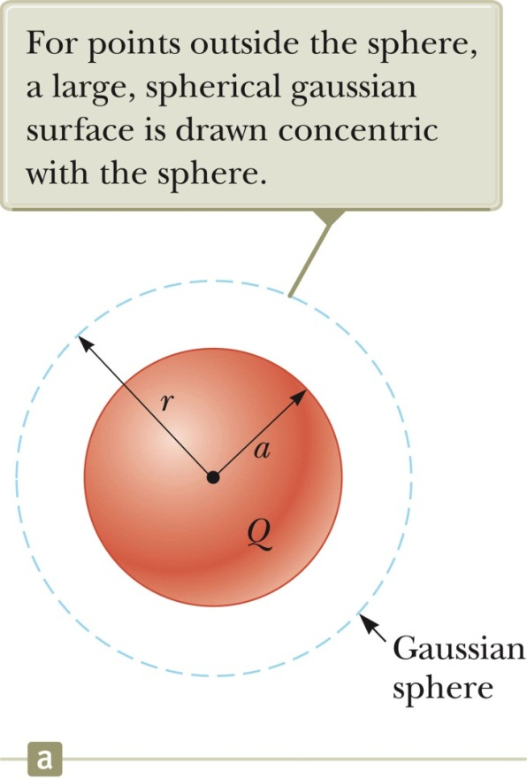
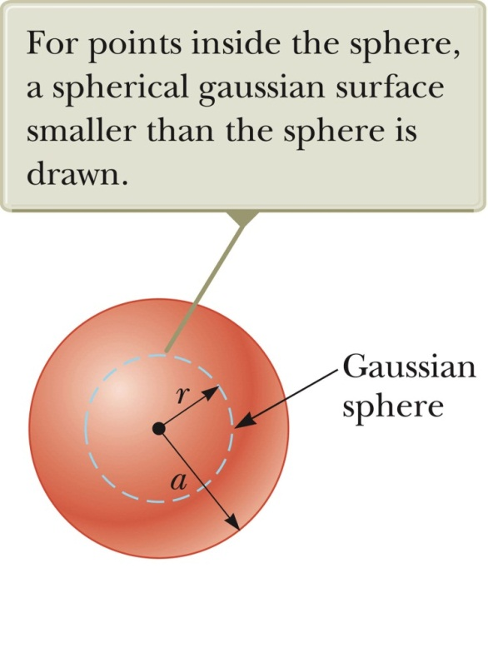

Exp. 1: Field Due to a Spherically Symmetric Uniform Charge Distribution
Website: Direct integration for Uniformly Charged Sphere
Spherical Symmetry
Select a sphere as the Gaussian surface.
For r > a: Choose surface in Fig (a)
An insulating solid sphere of radius a has a uniform volume charge density ρ and carries a total positive charge Q. Calculate the magnitude of electric field at a point inside and outside the sphere.
$$\begin{matrix}\begin{aligned}Φ_{E}=\oint{\vec{E}⋅d\vec{A}}=\frac{q_{ _{in}}}{ε_{o}} \\ \oint{EdA}=\frac{Q}{ε_{o}} \\ E\oint{dA}=\frac{Q}{ε_{o}} \\ E(4πr^{2})=\frac{Q}{ε_{o}}\end{aligned} \\ E=\frac{Q}{4πε_{o}r^{2}}=k_{e}\frac{Q}{r^{2}}\end{matrix}$$
(a)
(b)
Notes:
Direct integration for Uniformly Charged Sphere
https://math.stackexchange.com/questions/486293/electric-field-of-a-spherical-shell

Slide 15


Exp. 1: Field Due to a Spherically Symmetric Uniform Charge Distribution
Select a sphere as the Gaussian surface.
For r < a: Choose surface in Fig (b)
$q_{in}=Q\frac{(4/3)πr^{3}}{(4/3)πa^{3}}=Q\frac{r^{3}}{a^{3}}$
An insulating solid sphere of radius a has a uniform volume charge density ρ and carries a total positive charge Q. Calculate the magnitude of electric field at a point inside and outside the sphere.
$$\begin{matrix}\begin{aligned}Φ_{E}=\oint{\vec{E}⋅d\vec{A}}=\frac{q_{in}}{ε_{o}} \\ E\oint{dA=\frac{q_{in}}{ε_{o}}}\end{aligned} \\ E=\frac{q_{in}}{4πε_{o}r^{2}}=k_{e}\frac{Q}{a^{3}}r\end{matrix}$$
(a)
(b)

Slide 16
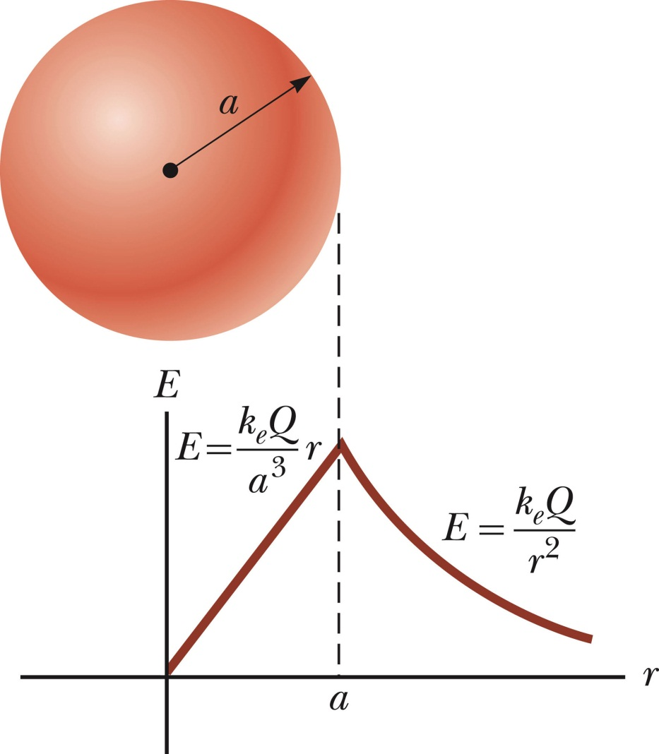
Spherically Symmetric Distribution, summary
Inside the sphere, E varies linearly with r
E → 0 as r → 0
The field outside the sphere is equivalent to that of a point charge located at the center of the sphere.

Slide 17
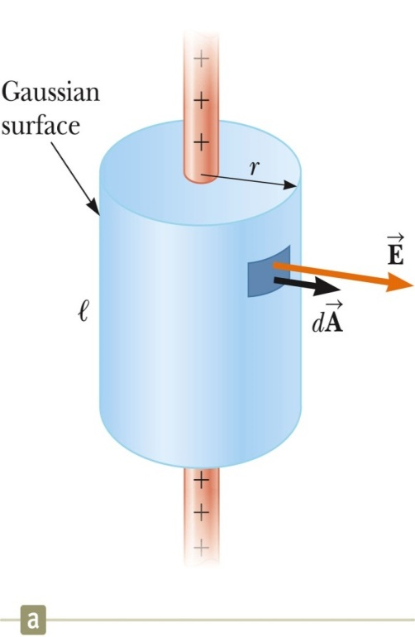
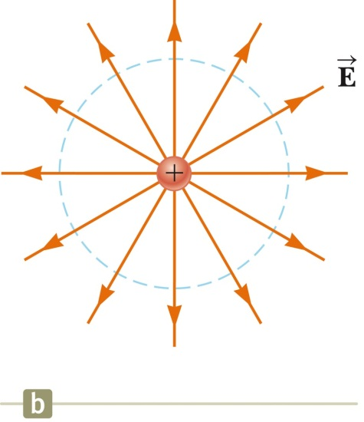


Exp. 2: Field at a Distance from a Line of Charge
Cylindrical charge distribution (cylindrical symmetry).
Select a cylinder (radius of r & length of ℓ) as Gaussian surface.
points in the radial direction (perpendicular to the surface) and is constant in magnitude at every point on the curved part of the surface. (Why?)
Use Gauss’s Law to find the field.
The field through the ends of the cylinder is 0 since the field is parallel to these surfaces.
++++
++++

Slide 18
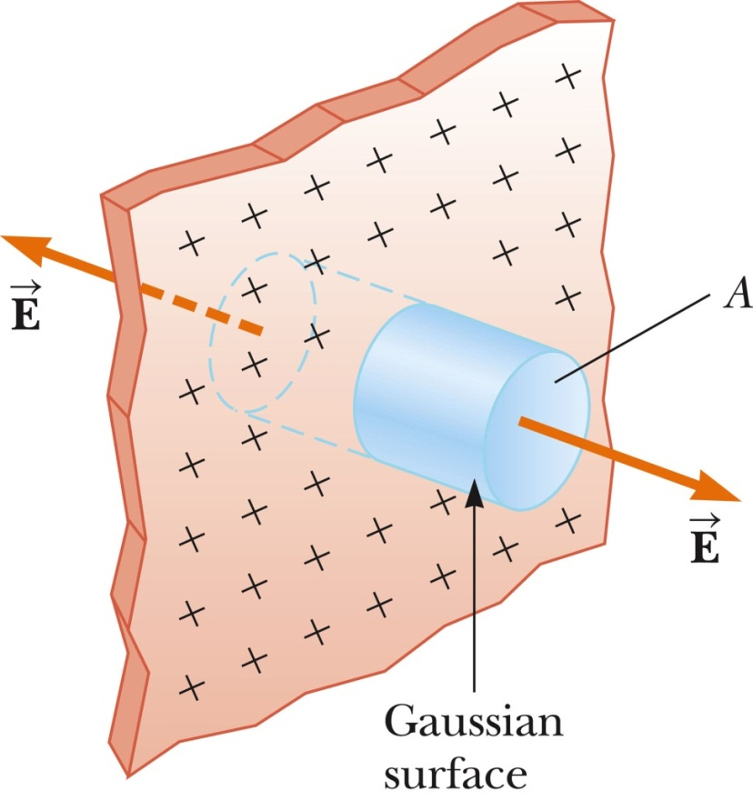
Exp. 3: Field Due to a Plane of Charge
++++++++++++++++++++++++++++
++++++++++++++++++++++++++++
must be perpendicular to the plane (Why?)
and must have the same magnitude at all points equidistant from the plane. Choose a small cylinder whose axis is perpendicular to the plane as the Gaussian surface.
Only the top and bottom surfaces of the Gaussian surface contribute to the electric flux.
The flux through each end of the cylinder is EA and so the total flux is 2EA.
The total charge inside the Gaussian surface is σA.
Applying Gauss’s law:
Note, E does not depend on r.
Therefore, the field is uniform everywhere.

Slide 19
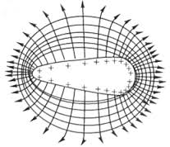
Exp. 4: Properties of a Conductor in Electrostatic Equilibrium
When there is no net motion of charge within a conductor, the conductor is said to be in electrostatic equilibrium.
(P1) The electric field is zero everywhere inside the conductor.
Whether the conductor is solid or hollow
(P2) If the conductor is isolated and carries a charge, the charge resides on its surface.
(P3) The electric field at a point just outside a charged conductor is perpendicular to the surface and has a magnitude of σ / ɛ_{0.}
σ is the surface charge density at that point.
(P4) On an irregularly shaped conductor, the surface charge density is greatest at locations where the radius of curvature is the smallest.

Slide 20
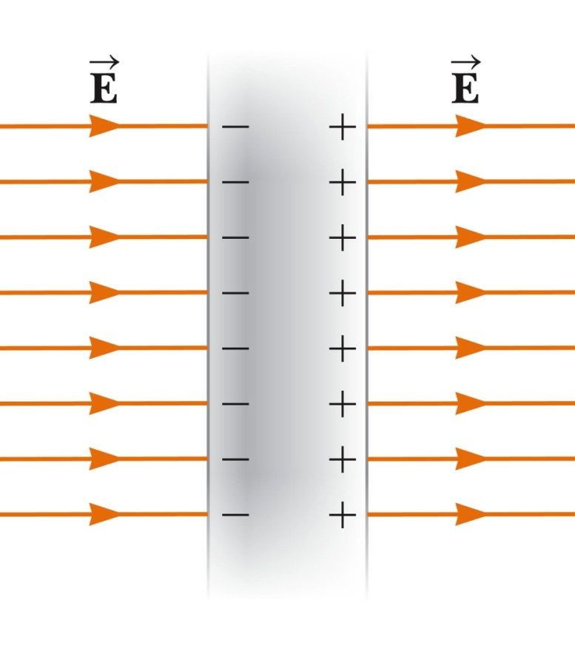
Property 1: Field_{inside} = 0
Consider a conducting slab in an external field.
If the field inside the conductor were not zero, free electrons in the conductor would experience an electrical force.
These electrons would accelerate and would not be in equilibrium. Therefore, there cannot be a field inside the conductor.
Before the external field is applied, free electrons are distributed throughout the conductor.
When the external field is applied, the electrons
redistribute until the magnitude of the internal field equals the magnitude of the external field, resulting in a net field of zero inside the conductor.
This redistribution takes about 10⁻¹⁶ s and can be considered instantaneous.
If the conductor is hollow, the electric field inside the conductor is also zero.

Slide 21
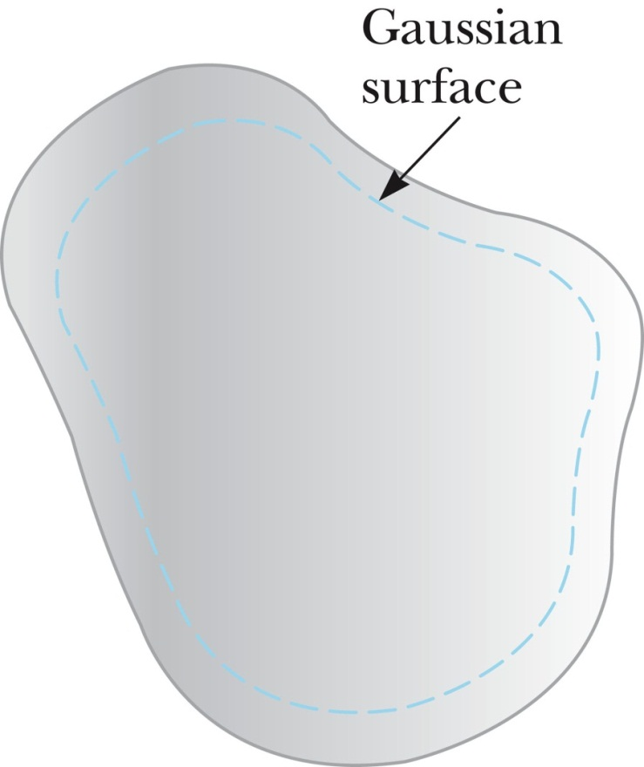
Property 2: Charge Resides on the Surface
Choose a Gaussian surface inside but close to the actual surface.
The electric field inside is zero (property 1).
There is no net flux through the Gaussian surface.
Because the Gaussian surface can be as close to the actual surface as desired, there can be no charge inside the surface.
Since no net charge can be inside the surface, any net charge must reside on the surface.
Gauss’s law does NOT indicate the distribution of these charges, only that it must be on the surface of the conductor.

Slide 22
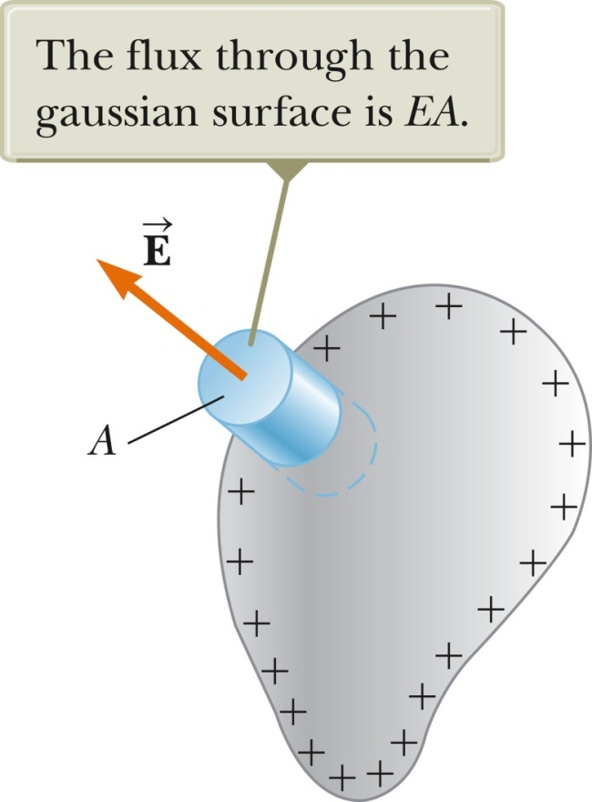
Property 3: Field’s Magnitude and Direction
Choose a cylinder as the Gaussian surface.
The field must be perpendicular to the surface.
If there were a parallel component to , charges would experience a force and accelerate along the surface and it would not be in equilibrium.
The net flux through the Gaussian surface is through only the flat face outside the conductor.
The field here is perpendicular to the surface.
Applying Gauss’s law:
Section 24.4

Slide 23
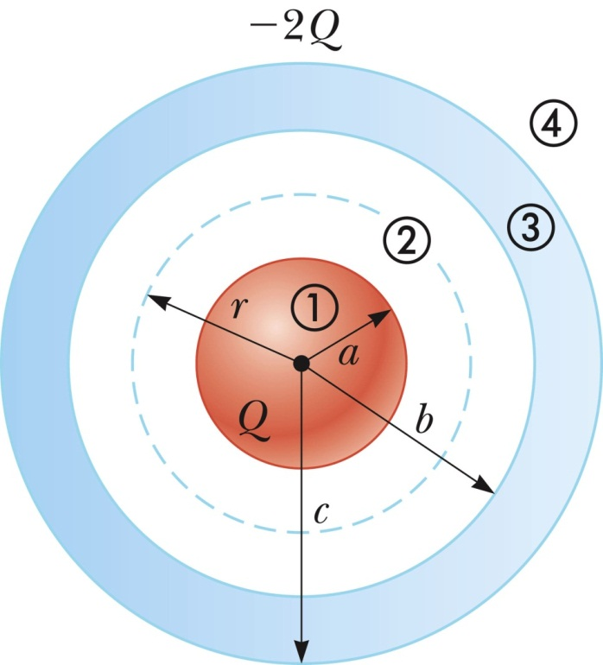
Exp. 5: Sphere and Shell Example
Conceptualize
Similar to the insulating sphere example
Now a charged insulating sphere is surrounded by a conducting shell
Note different charges on the sphere and shell
Categorize
System has spherical symmetry
Gauss’s Law can be applied
Analyze
Construct a Gaussian sphere between the surface of the solid sphere and the inner surface of the shell: Region 2, a < r < b; Charge inside is +Q
The electric field lines must be directed radially outward and be constant in magnitude on the Gaussian surface.

Slide 24
Exp. 5: Sphere and Shell Example, summary
The electric field for each area can be calculated.
Finalize
Check the charge distribution: -Q on the inner surface and the other -Q on the outer surface.
Think about other possible combinations.
What if the sphere were conducting instead of insulating?

